Slide 1
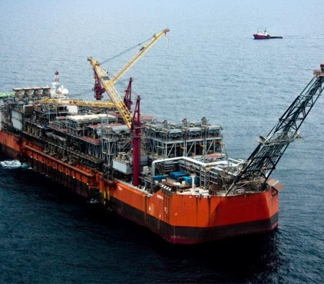
Bonga DW Asset Quarterly Business Review (HSE)

Slide 2


Safety & Environment – 2019 Key Promises Schedule
SN | Projects | Progress % |  |  | 2019 |  |  |  | Planned Completion |  | Comments
 |  | Base | Act. | Var. | Q1 | Q2 | Q3 | Q4 | Promise | LE
1 | Roll out 2019 Bonga DW AAP & SE AIPSM Implementation Plan. | 100 |  |  |  |  |  |  | January | Feb | Completed
2 | Awareness/Training session on auditing for LOD 1 auditors | 100 |  |  |  |  |  |  | March | Apr | Completed knowledge and skill training for Bonga personnel
3 | Bonga HSE Case Review (Part 3 and annex 3A) | 100 |  |  |  |  |  |  | April | May
4 | Facilitate the 2019 Safety Day Events and Oloma Memorial for Bonga DW Asset team | 100 |  |  |  |  |  |  | May/Nov | Mar | Completed
5 | Environmental Aspects Champions’ and Bonga HSE Team members workshop | >90 |  |  |  |  |  |  | May
6 | Deep Water Production Contractor CEO HSE Engagement Workshop | >80 |  |  |  |  |  |  | July
7 | Hold learning summits (use a blend of past activity related incidents and identified risks based on exposure prediction) | 100 |  |  |  |  |  |  | Sept.
8 | Monitoring Implementation of all LOD 1 activities and NCR form when not completed | >90 |  |  |  |  |  |  | Monthly |  | Insights are shared monthly on completed LOD 1
9 | Effectiveness of Closed-out Radar and FIM items | >70 |  |  |  |  |  |  | Quarterly |  | Q1 and Q2 review completed.
10 | Update of the Hazardous Area Classification Drawing | 100 |  |  |  |  |  |  | September
11 | Bonga DW Asset HSSE & SP MS Management Review | 100 |  |  |  |  |  |  | November
12 | Safety Leadership coaching sessions and family head connects with LT | 100 |  |  |  |  |  |  | November |  | Held monthly connect
13 | Review Bonga Asset HSE documents to align with current organizational structure | 100 |  |  |  |  |  |  | December |  | Ongoing (Completed HSSE Case &MIP)
 |  | Plan | Act. | Var. | Q1 | Q2 | Q3 | Q4 | Promise | LE
2
Project Decision Gates
Project Completion (Baseline)
LE Schedule Acceleration
LE Schedule Slippage

Slide 3
Bonga SE KPIs @ YTD June 2019

Slide 4
Bonga SE KPIs @ YTD June 2019

Slide 5
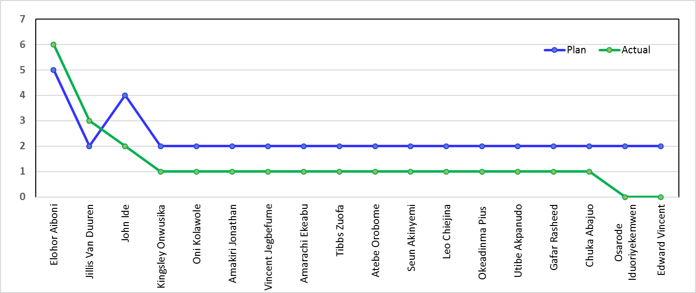
Asset LT MFE Performance @ End June 2019
% Performance (59%)
Improved MFE Performance Vs 2018

Slide 6
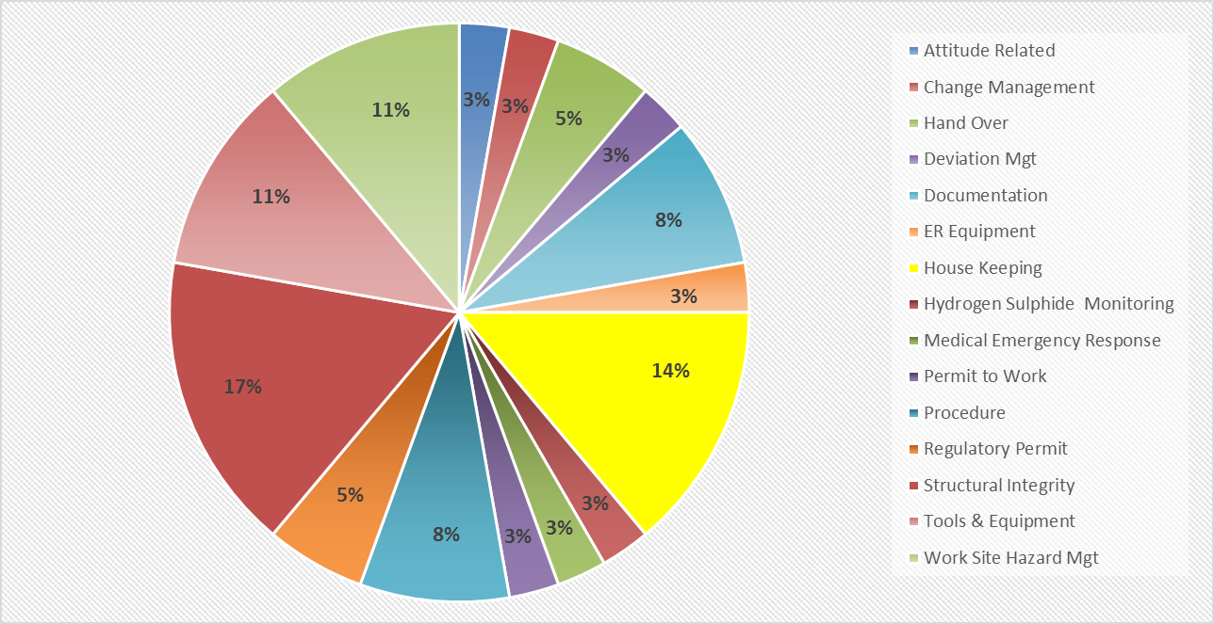
Annual Assurance Plan Compliance
LOD - 1 Plan Compliance: ~ 124%
LoD-2 Activity Plan Compliance: ~ 58%

Slide 7
End Q2 SoC Performance
Improved SoC close Out compared to 2018
Commenced process of feed back to SoC reporters
Bulk of open SoC material related

Slide 8
YTD Key SE Activities
Held Learning Summit sessions with 5 REG (Construction, Catering, maintenance, Marine and Operation). Focused on Failure to learn from previous incidents
Completed the DPR 2019 SNEPCo HSE Audit, Facility Inspection and Oil Spill Contingency Plan (OSCP) Activation Exercise. Zero non-conformance recorded and fewer observations made compared to previous years
Completed the following LOD-2 activities:
ISO 14001:2015 Internal Audit
Materials Management and Maintenance Strategy Review
SCiN EMP Review of Bonga Asset Practices
OPITO CMS monitoring audit
Bonga FPSO Lifting - Assurance Audit
Held the Bonga Facilities Management and Catering contract performance review with both SNEPCo and Contractor representatives in attendance.
Completed the Bonga FPSO passing valve LOD-2 assessment, with Interview and document reviews.
Technical (HSE) Evaluation of Nitrogen Purging and the Bonga catering services contracts
GHG management workshop completed
Commenced AIPSM review with the Asset LT
Held 1 Process Safety Clinic with the Corporate Technical Safety Team

Slide 9
Q3 SE Activities Look Ahead

